Slide 1
Classroom Rules and Procedures
Middle School Team

Slide 2
Electronic Devices
Electronic devices, such as cell phones and tablets are not to be used in school.
1st offense : Take phone to the office and get it back at the end of the day
2nd offense: Take phone to the office and you cannot get it back until a parent or guardian comes to pick it up
3rd offense: Take the phone and you do not get it back.

Slide 3
Tardy
1st offense: Warning
2nd offense: Parent phone call
3rd + offense: Parent phone call + Silent Lunch

Slide 4
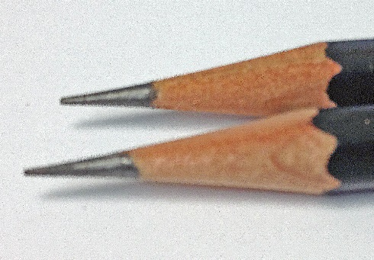
Pencil Sharpener
Come to class with pencil sharpened
Do not sharpen pencils if teacher is talking

Slide 5
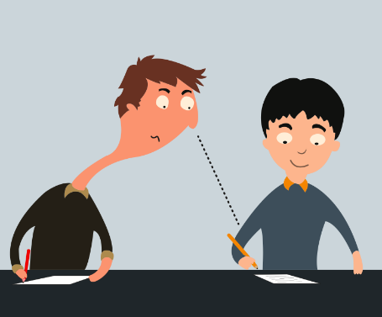
Testing Rules
No Talking
No Copying
When finished, stay quiet and complete given assignment

